Slide 1






How To Stop Poachers Stealing Your Pandas
Matthew Bradbury
Was: PhD Student at Computer Science
Now: Postdoctoral Researcher at WMG
@MattBradbury_
@pintofscience #pint18

Slide 2
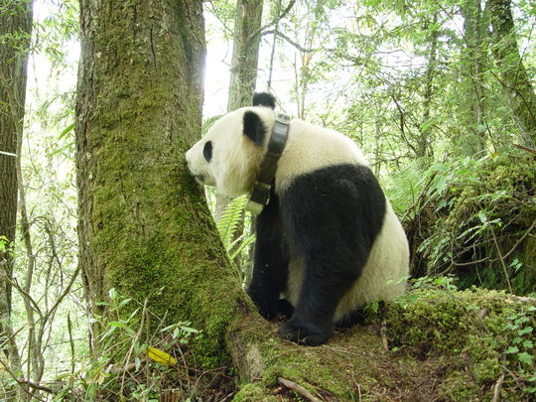
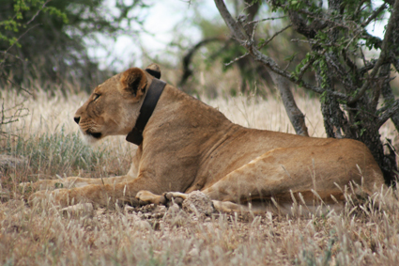
Technology Is Used For Animal Conservation
globalgiving.org/projects/savingpandas/
GROUND Lab home.groundlab.cc/lioncollars.html
@MattBradbury_
@pintofscience #pint18

Slide 3
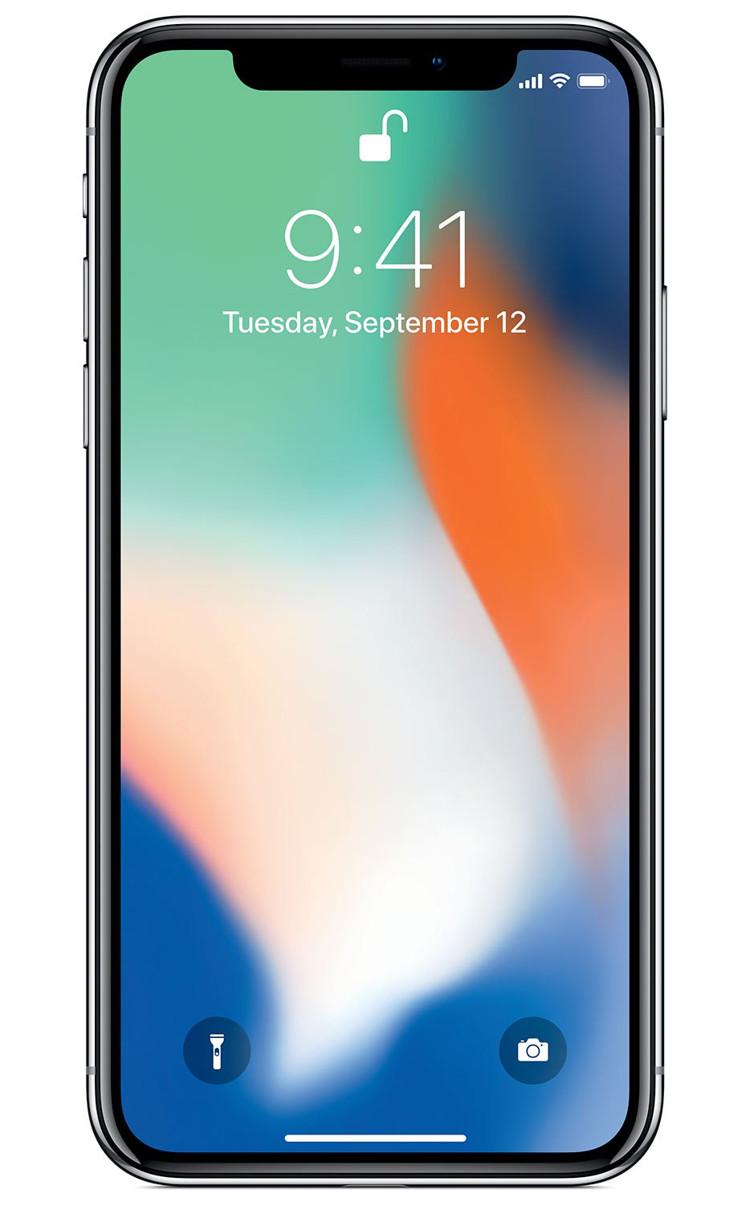
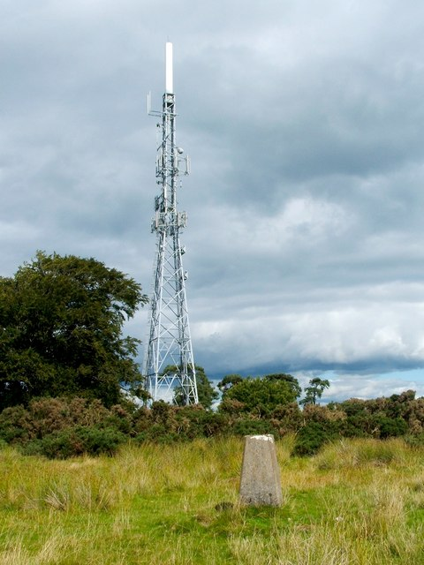
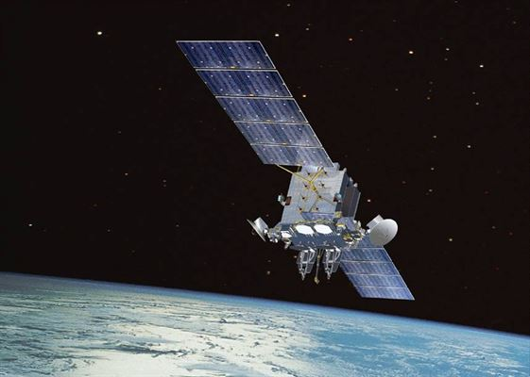
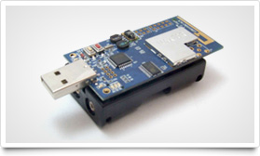


Conservationists Need To Gather Animal Location Data
Mobile phone infrastructure often unavailable
Satellite communications are too expensive
Use cheap sensor nodes instead
@MattBradbury_
@pintofscience #pint18

Slide 4






Wireless Sensor Networks
@MattBradbury_
@pintofscience #pint18

Slide 5

Poachers Will Take Advantage Of The Technology
Photo by @Amivee taken at the Wolong National Nature Reserve
@MattBradbury_
@pintofscience #pint18

Slide 6
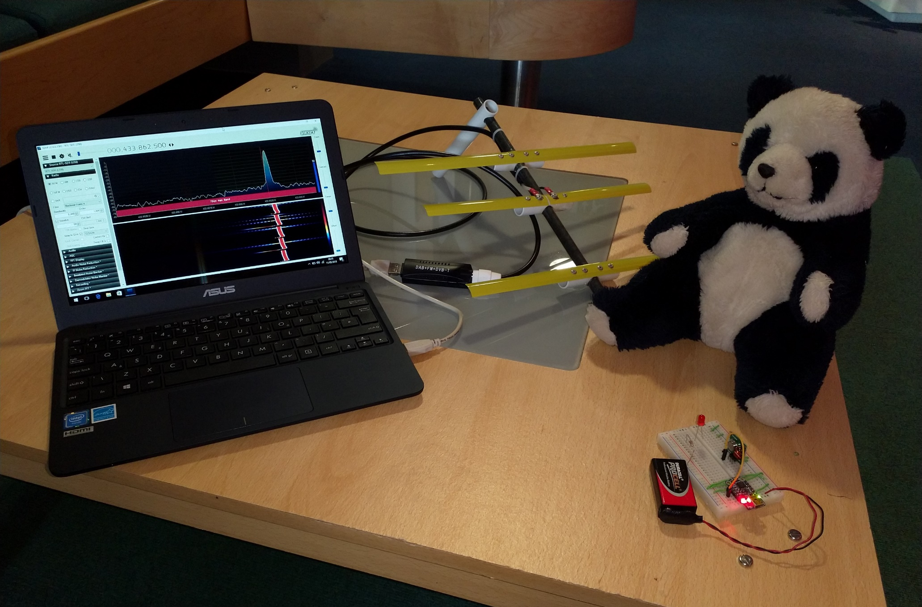
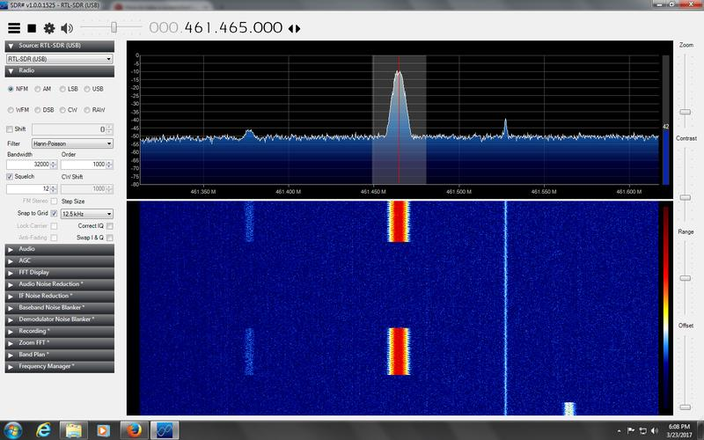
Demo: A High-Tech Game Of Hide And Seek
@MattBradbury_
@pintofscience #pint18

Slide 7





How To Stop Poachers Using This Information?
@MattBradbury_
@pintofscience #pint18

Slide 8



Fake Sources
@MattBradbury_
@pintofscience #pint18

Slide 9



Fake Sources
@MattBradbury_
@pintofscience #pint18

Slide 10



Diversionary Routes
@MattBradbury_
@pintofscience #pint18

Slide 11
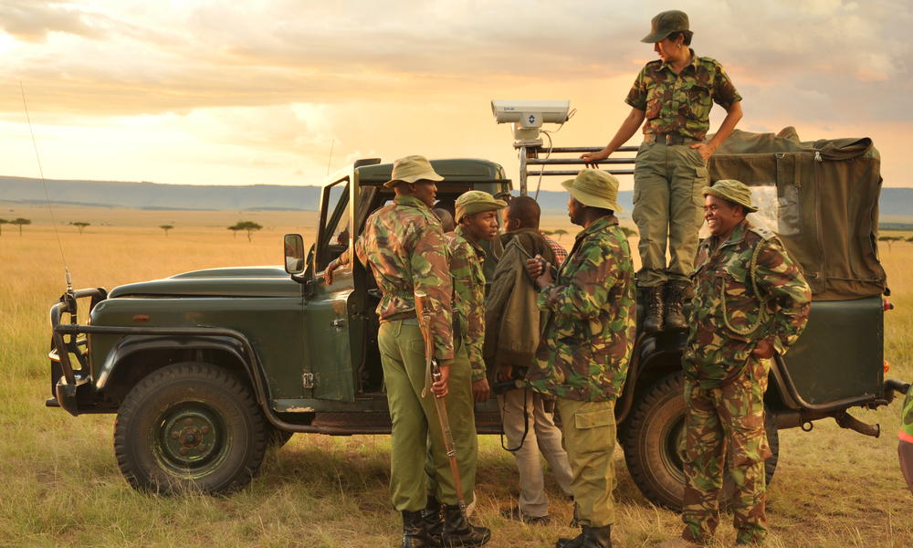
A People Component Is Still Required
worldwildlife.org/projects/wildlife-crime-technology-project
@MattBradbury_
@pintofscience #pint18

Slide 12
Your Location Privacy Is Important Too!
@MattBradbury_
@pintofscience #pint18

Slide 13
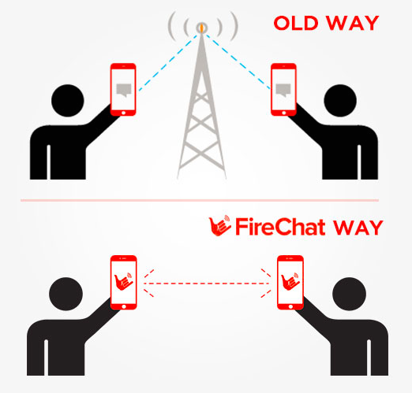

Future Work: Location Privacy In Ad-Hoc Messaging
@MattBradbury_
@pintofscience #pint18

Slide 14
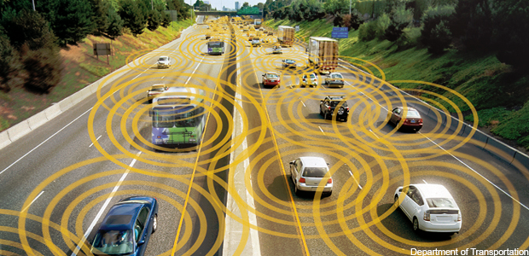
Future Work: Location Privacy In Intelligent Vehicles
@MattBradbury_
@pintofscience #pint18

Slide 15
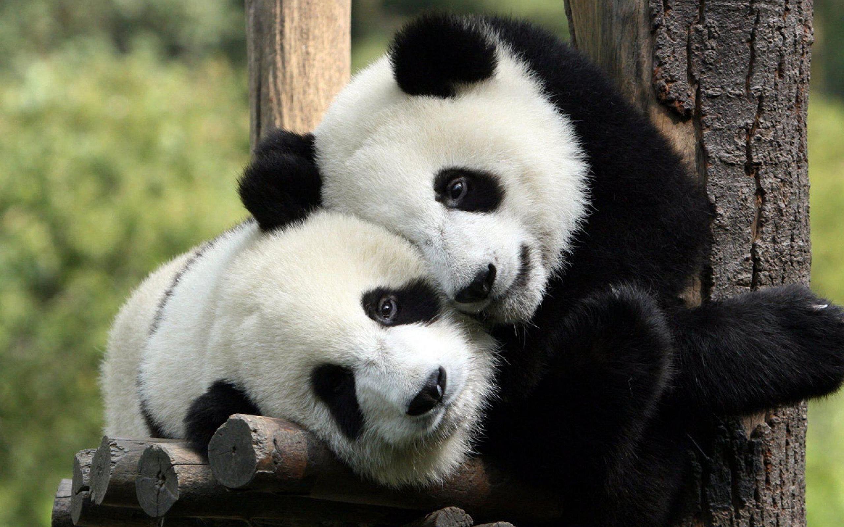
Thank You For Listening!
@MattBradbury_
@pintofscience #pint18

